Slide 1
Data presentation issues
Notes from the lecture given by brian macmillan on October 1, 2013 for DM997X at nyu-poly

Slide 2
issues WHEN presenting data
What is being represented by your data?
What is the point of the representation (what is being communicated)?
Who is the audience?

Slide 3
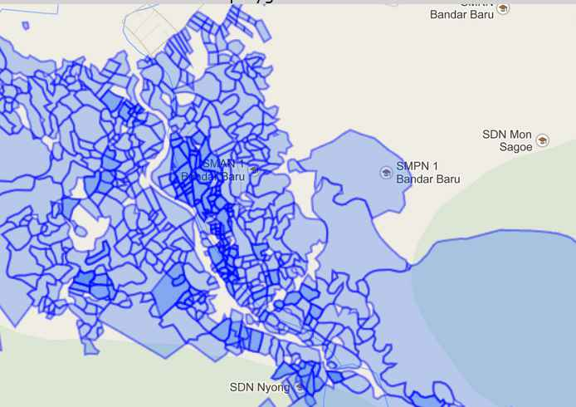
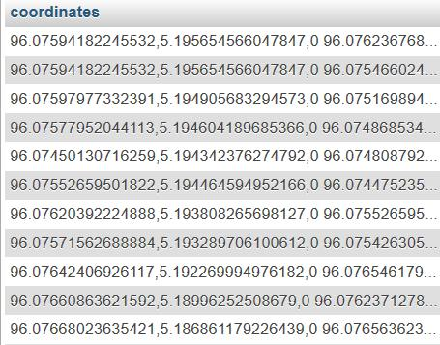
What is being represented?
The nature of data itself imposes structures on your work. For example, geo-location data are best represented visually.
Figure 1: The co-ordinate data in the right hand column are much easier to understand when graphed as polygons on a map.

Slide 4
Types of charts and the data they represent

Slide 5
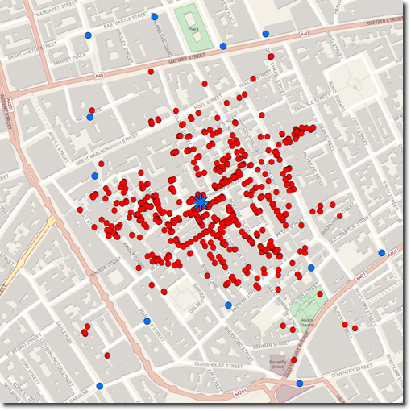
Choosing the right chart can make a big difference
John Snow’s cholera distribution map helped to identify a water pump as the source of an epidemic in London in 1854.
John Snow’s graphing of cholera distribution (above) successfully identified the source of the 1854 London cholera epidemic, a contaminated well.

Slide 6
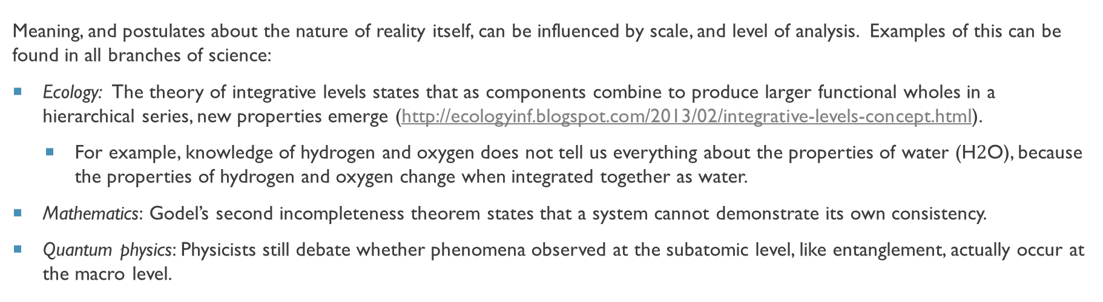
Scale (and level of analysis) Matters
Meaning, and postulates about the nature of reality itself, can be influenced by scale, and level of analysis. Examples of this can be found in all branches of science:
Ecology: The theory of integrative levels states that as components combine to produce larger functional wholes in a hierarchical series, new properties emerge (http://ecologyinf.blogspot.com/2013/02/integrative-levels-concept.html).
For example, knowledge of hydrogen and oxygen does not tell us everything about the properties of water (H$2$O), because the properties of hydrogen and oxygen change when integrated together as water.
Mathematics: Godel’s second incompleteness theorem states that a system cannot demonstrate its own consistency.
Quantum physics: Physicists still debate whether phenomena observed at the subatomic level, like entanglement, actually occur at the macro level.

Slide 7
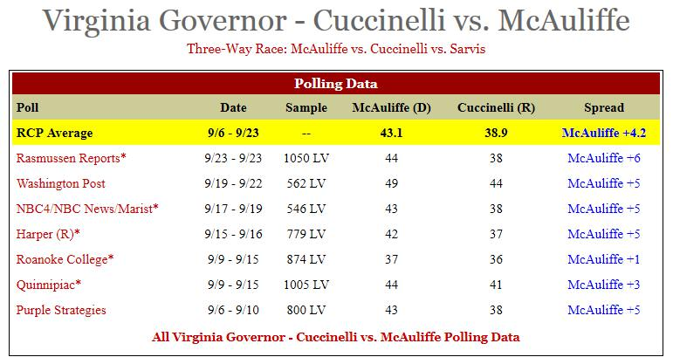
The specificity and nature of measurements also matter
Significant digits, sample sizes and margins of error all impact meaning.
Too small a sample size renders certain data sets meaningless.
A non-randomized sample is also meaningless, in terms of representing a population.
A small randomized sample can be more representative of a population than a huge non-randomized sample.
Large margins of error can suggest differences where they do not exist, or are unknown.
Insignificant digits are noise that should be avoided.
Polls are often presented as more accurate than they are. Most have a margin of error of +/- 3-5% 19 times out of 20, which would render most of the differences between the two candidates, above, statistically insignificant (http://en.wikipedia.org/wiki/Margin_of_error).

Slide 8
Quantification: Completeness
When assessing a sub-set of data it is helpful to view the whole data set.

Slide 9
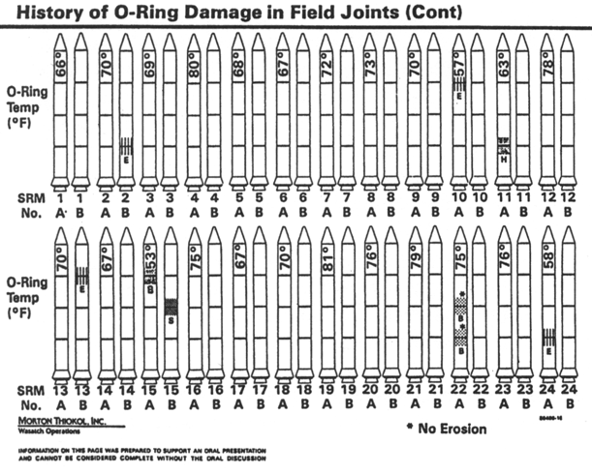
Quantification: Ordering
The data visualization expert Edward Tufte’s famous study of the Challenger shuttle crash illustrates the importance of both completeness and ordering to data analysis.
The difficult to understand illustration on the right, of temperature impacts on shuttle structural integrity, failed to identify a fatal problem because the data was organized chronologically, rather than by temperature. Also, the data set was incomplete and included irrelevant information.
See http://people.rit.edu/wlrgsh/FINRobison.pdf for a more detailed explanation of this famous analysis.

Slide 10
Limits and thresholds
Limits
In data modeling, using an inappropriate data type can create unnecessary constraints on a system. For example, using a byte field to represent members of a large population can create problems because one byte can only represent 256 items.
Thresholds
Many substances are not poisonous until a certain threshold is reached. Analogous situations exist in many other areas.

Slide 11
Aggregation
A data set that works fine by itself may break when aggregated with other data sets that represent similar data.
For example, in data sets that get aggregated you need to ensure that key fields are globally unique.

Slide 12
The presentation of data has a human component

Slide 13
People are better at relative evaluations than absolute ones.
People are much better at ranking (relative ordering) than dealing with absolute values.
For example, they may not be able to tell you if the United States national debt is in billions or trillions of dollars, but they will always be able to tell you that it is bigger than their personal debt.

Slide 14
People have limits to what they can comprehend
Large numbers quickly become meaningless without a context.
Sequences involving more than 4 or 5 steps are extremely difficult for people to remember.

Slide 15
Culture influences perception and understanding
Our perceptions of space, time and color are all influenced by culture:
Space: some cultures orient exclusively by absolute directions (for example, north and south) rather than relative ones (right and left).
Time: the Chinese language describes past, present and future events through aspect whereas English uses tense.
Color: every culture has factions that identify themselves and their ideology through colors. These vary between cultures, for example, blue in Canada is associated with conservatives, and in the United States it is associated with liberals.

Slide 16


Louis Cheskin and Color
Louis Cheskin laid the groundwork for all modern packaging through his color research, which he conducted during the 1940s and 1950s at the Color Research Institute of Chicago (later the Louis Cheskin Institute).
His research is one of the reasons why Tide, Proctor and Gamble’s most profitable detergent, is packaged in orange and yellow, and the packaging of Cheer, a product designed primarily to take up shelf space, is predominantly blue. His research suggests that despite certain cultural associations with color, there are others that occur cross-culturally (for example, orange attracts the human eye).

Slide 17
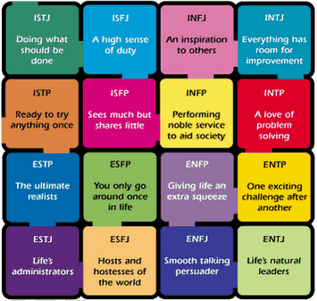
PeoplE understand The world in different ways
People comprehend the world differently:
Some people make decisions based on numbers.
Others rely on visual cues.
Others make decisions based on character assessments.
The researchers Katherine Cook Briggs, and her daughter Isabel Briggs Myers, developed a psychometric questionnaire to measure these differences, based on Jung’s belief that cognitions is influenced by sensation, intuition, feeling, and thinking. Their model outlined two polar types, with four personality characteristics each:
ESTJ: extraversion (E), sensing (S), thinking (T), judgment (J)
INFP: introversion (I), intuition (N), feeling (F), perception (P)
These characteristics can be combined into sixteen different personality types (see illustration).

Slide 18
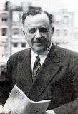
Bernays and the Freudians
Some people argue that people are mostly motivated by instincts (and needs) not reason and evidence.
The advertiser Edward Louis Bernays is one of the most famous.
Bernays preferred to use contrived news, featuring role models, and campaigns focused on self-esteem, to promote products.
Bernays famously, and successfully, encouraged women to smoke publicly during the 1929 Easter Parade, where he hired flappers to smoke Lucky Strikes.
Edward Louis Bernays

Slide 19
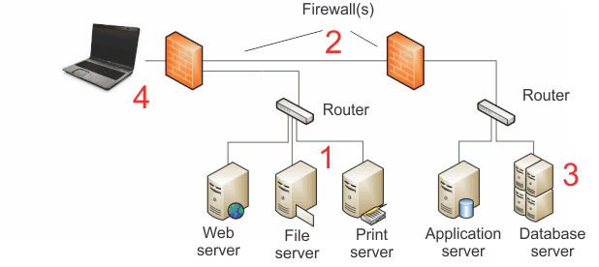
Never forget the human element, it can be more important than the technical details you are presenting
With non-technical audiences, building trust and credibility are often more important than technical details, but can be enhanced through the use of technical illustrations.
In the presentation illustrated below, which was given to psychologists and sociologists, I presented technical information in a list (left) and drew a picture of it to make it more accessible (right), but then focused entirely on inter-personal communication to develop procedures to address the problems we were discussing.
The primary purpose of the illustrations and technical information was to establish my credibility, by making me appear systematic and organized, NOT to convey information to my non-technical audience.
SMB 1 and 2 conflicts may be destabilizing the system.
Firewalls may be restricting access because of authentication, timeout and threshold rules.
Database indexes may be corrupt.
A mismatch of Cat 5, Cat5e and Cat 6 cables may be slowing down the network; a known error with networks cards on Optima 780 machines may be causing periodic connectivity failures.

Slide 20
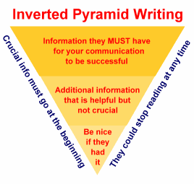
Despite variations in approach, there are Still certain Guidelines you should keep in mind
It is usually best to start with the most important or representative point first. Journalists call this the inverted pyramid rule.
Speak the language of the audience. Be aware of how they “encode”, for example, what symbolic paradigms they use. These can relate to color, dress, dialect, and many other factors.

Slide 21
Outtake: Quantification versus Dequantification
Often, data is dequantified in presentations. For example, scales may be removed from a chart.
Why would you want to dequantify, and break the analytical rules discussed previously?
Deception
Obfuscation
Emphasis

Slide 22
Dequantification: reasons to dequantify
Emphasize aspects of the data
Direction of a data series (for example the debt clock) can be more important than the actual numbers being represented
Use other, non-numeric types of communication
e.g. visual information like videos and slide-shows
Scale and source citations take away screen real-estate from potentially more important information, for example the shopping cart, if the purpose of your presentation is to sell something.

